Slide 1


TECHNICAL COMMUNICATION (KAS – 301)
UNIT – 2
TOPIC : TECHNICAL REPORT
Presented by
Dr. RENUKA
Assistant professor
Applied Science and Humanities
IMS Engineering College, Ghaziabad

Slide 2
REPORT
The word ‘report’ is derived from the Latin reportare—‘to bring back’.
It has evolved to mean that the gathered information is unbiased and evidence based.
A report is usually a piece of factual writing, based on evidence, containing organized information on a particular topic.
It is a major form of technical/business/professional communication. A person transmits certain facts, ideas, or suggestions useful for another person through a report. It can also be the description of an event or a condition.

Slide 3
Importance of Reports
A report is the only tangible product of a professional.
Reports enable decision-making and problem solving in organizations.
Reports help the authorities in planning new ventures and in evaluating men and material.
Reports are an important means of information dissemination within and outside the organization
Reports serve as a measure of the growth, progress, or success of an organization
Reports serve as a valuable repository of information.
Reports reveal gaps in thinking
Reports develop certain skills in the writer.

Slide 4
Objectives of Reports
Present a record of accomplished work. (project report)
Record an experiment. (primary research report/laboratory report)
Record research findings or technical specifications (a report on the details of a new product)
Document schedules, timetables, and milestones (a status report on a long-term plan)
Document current status (an inspection report)
Record and clarify complex information for future reference (a report on policies and procedures)
Present information to a large number of people (annual report)
Present organized information on a particular topic (a report describing the working of various divisions of an organization)
Recommend actions that can be considered in solving certain problems (recommendatory report)

Slide 5
CHARACTERISTICS OF A REPORT
Precision
Factual details
Relevance
Reader-orientation
Objectivity of recommendations
Simple and unambiguous language
i) Clarity ii) Brevity iii) grammatical accuracy iv) special format
v) Illustration vi) Homogeneity vii) Documentation

Slide 6
CATEGORIES OF REPORTS
Informative, analytical (purpose)
Periodic, special (frequency)
Oral, written (mode of presentation)
Long, short (length)
Formal, informal (approach)
Individual, group (target audience)

Slide 7
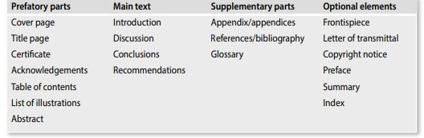
STRUCTURE OF REPORTS

Slide 8
Cover page and frontispiece
The cover page of the report not only gives it an elegant appearance but also protects it from damage.
It also serves as a quick reference to the readers to know the topic and the author of the report.
The classification of the report (secret/top secret) and report number, if applicable, may also be mentioned on the cover page on the top left corner and right corner, respectively.
To stir the curiosity of the reader, one may superimpose on this cover page some illustrations, such as photographs, drawings, and diagrams, provided these illustrations reflect the contents of the report.
For example, a report on ‘Designing Webpages’ can have a webpage superimposed on the cover. Any such illustration is known as the frontispiece, which is an optional element, and generally finds a place in reports that are published.

Slide 9
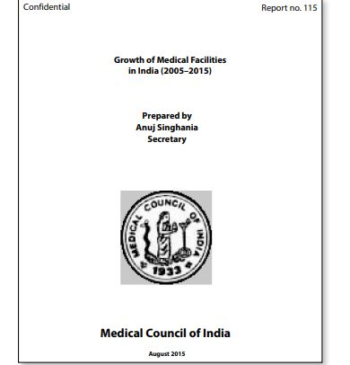
COVER PAGE ( Sample)

Slide 10
Title page
The title page is the first right-hand page of a report.
This page is more or less similar to the cover page, except that it contains the following additional information:
Name and designation of the intended audience
Name and designation of the approving authority, if any.
If needed, the organization’s emblem can be included just above its name given at the bottom

Slide 11
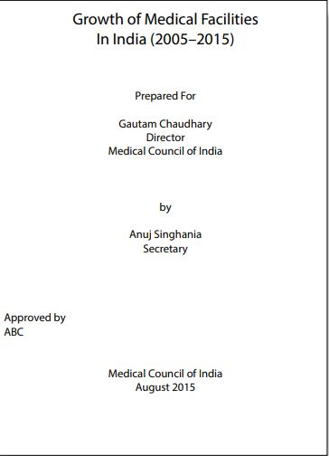
TITLE PAGE (Sample)

Slide 12
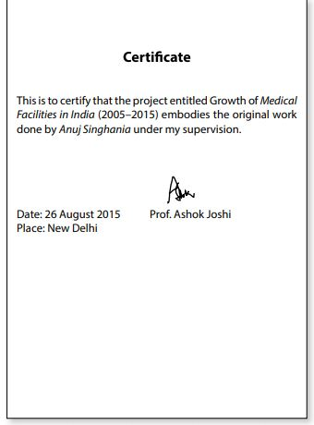
Certificate
Certain reports, such as project reports and research reports require a certificate vouching the original contribution of the report writer.
Generally, the certificate contains the statement testifying the original work, place, date, and signature of the project supervisor or guide.

Slide 13
Letter of transmittal
An optional element of reports, the letter of transmittal (or memo of transmittal) conveys the report to the audience.
This serves the same purpose as that of a preface in a published document.
The transmittal letter usually appears right before the table of contents.
The contents of a letter of transmittal are
Objectives/terms of reference
Scope
Methodology adopted
Highlights of the analysis
Important results
Significance of the study Suggestions
Any other details that may enable the audience to understand the report better
Acknowledgements

Slide 14
Acknowledgements
This is a list of persons whom we may like to thank for their advice, support, or assistance of any kind.
It is not only customary but also necessary to acknowledge even the smallest help rendered by people.
While writing the ‘Acknowledgements’, the following guidelines should be remembered:
Categorize the audience: Courtesy, real help, emotional support, secretarial assistance, etc.
Vary the expressions: Do not begin each sentence with ‘I thank’; such a monotonous beginning will reduce the impact of the acknowledgements. Here are a few openings: Thanks are due to … Inadequate to express my sincere thanks to … Our sincere appreciation to … I am extremely grateful to … We owe a lot to … My heartfelt thanks are due to … Mere thanks in few words would be highly … I acknowledge with thanks the support rendered by …
Avoid clichés such as: First and foremost Firstly ......... secondly ......... thirdly Last but not the least I take this opportunity to thank ...
Avoid listing the names
Divide the content (if long) into well-structured paragraphs

Slide 15
Table of contents
‘Table of Contents’, generally titled simply ‘Contents’, helps the reader locate a specific topic easily and quickly.
It indicates, in outline form, the coverage, sequence, and relative importance of information presented in the report.
The Contents page is especially helpful to readers who wish to read only a few selected topics of the report.
The Contents lists all the three parts—prefatory, main, and supplementary—of the report along with their page numbers.
It also lists the illustrations used in the report

Slide 16
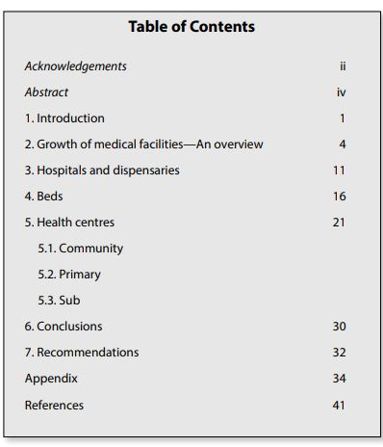

Slide 17
List of illustrations
This page serves as the Contents page for all the illustrations that appear in the report.
Except tables, all other visual aids (graphs, maps, drawings, and charts) are grouped under the heading Illustrations or Figures.
The List of Illustrations gives the titles and page numbers of all visual aids.
When tables and figures are numbered separately, they should also be listed separately.
These lists would enable the reader to quickly locate any specific illustration.

Slide 18
Abstract
An abstract gives the essence of the report.
In business reports it is known as the synopsis.
The length of an abstract is generally 2 to 5 per cent of the report.
If the report is less than ten pages it does not require either an abstract or a summary.
It tells the reader the following:
• Objectives • Main findings or accomplishments

Slide 19
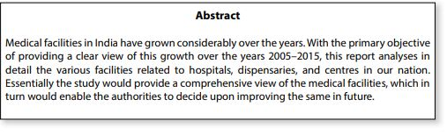

Slide 20
Summary
While an abstract is more appropriate in specialist-to-specialist communication, a summary, which is an optional element, is meant for all readers.
It is longer than an abstract, 5–10 per cent of the length of the report.
Business reports name ‘Summary’ as ‘Executive Summary’.
It presents the entire report in a nutshell.
Summaries may contain headings, adequately developed text, and even visual aids.
Generally, the summary of a report presents information from various parts of the report in the same sequence as they appear in the report.
After reading the summary, the audience should know the essentials of the report and be able to make a decision.

Slide 21
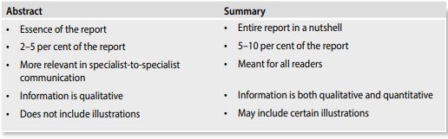
Difference

Slide 22
PREFACE
The preface, an optional element, is the preliminary message from the writer to the reader.
It is quite similar to the letter of transmittal, except that it does not formally transmit the report.
The contents of a preface are as follows:
Factors leading to the report (what was the prevailing situation or earlier studies carried out and hence the need for this study and report)
Organization of the report (what do the various sections contain)
Highlights (important observations and findings)
Significance (how the report would enable the readers in further study or research; how best the study in the report would help them)
• Generally, the preface appears only when the report gets published.

Slide 23
Copyright notice
Copyright is a form of protection that covers published and unpublished literary, scientific, and artistic works, whatever the form of expression, provided such work is executed in a tangible or material form.
Simply put, it means that if we can see it, hear it, and/or touch it, it may be protected.
Copyright laws grant the creator the exclusive right to reproduce, prepare derivative works, distribute, perform, and display the work publicly.
For example, a copyright statement that reads ‘© Copyright 2015, OUP, India’ means that the Oxford University Press, India has legal monopoly over the work, which was produced in 2015. There is one thing that must be clarified, though. The actual intangible idea may not be copyrighted. What is copyrighted is the tangible result of the idea, which would be in the form of the published work. An example: © Copyright 2015 by Maxima Institute of Technology. All rights reserved. This material may not be duplicated for any profit-driven enterprise.

Slide 24
Main Text
The main text consists of
The Introduction
Discussion,
Conclusion,
Recommendations.
This is the main body of the report, which gives the details of the study such as the method adopted, data collection methods, and the constraints under which the study was carried out.

Slide 25
Introduction
The function of an introduction is to put the whole report in perspective and to provide a smooth, sound opening for it.
An introduction includes the following information:
Background of the report Conditions/events giving rise to the project or survey need to be discussed here. Details of previous investigations and studies can also be included if there is significant time gap.
Purpose and scope The background will logically lead to the purpose of the report. If the investigator has received the Terms of Reference, they can be presented verbatim. Otherwise the objectives have to be clearly specified. The purpose statement describes the objective as well as boundaries of the work. Stating which issues will be covered and which issues will not be covered is especially important in the case of complex, lengthy investigations.
Authorization The authority who has assigned to do the project/conduct the survey should be mentioned. In other words, the recipient’s name and designation should be mentioned.

Slide 26
iv ) Basic principles or theories involved The important theories and principles used for analyzing the data should be outlined.
v) Methods of gathering data The methods used or the sources consulted for collecting the data should be mentioned.
vi)General plan in developing the solution (brief outline of methodology) The methodology adopted in the analysis should be outlined.
vii)General structure of the report (organization of various sections) The Introduction may contain subheadings such as objectives and procedures, which serve as significant guideposts for the readers.

Slide 27
Discussion
The discussion section, the lengthiest part of the report, contains the information that supports the conclusion and recommendations, as well as the analysis, logic, and interpretation of the information.
Here, information and data are presented, analyzed, and interpreted.
The writer must decide between pertinent data to include in the text and less important information to omit or relegate to the appendix.
Meanings, ideas, and facts are made clear to the reader.
Comparisons are made, facts are evaluated, and significant relationships are drawn.
The solution of a problem may be given with an explanation of its advantages and disadvantages.
Tables, charts, and other media for presenting figures and data are used.
Other illustrative material may be included

Slide 28
Emphasis is on the results and their interpretation.
The discussion should lead the readers through the same reasoning process that the author used to reach the conclusions and show them that they are sound.
Opposing contentions should be considered to show how the data prove otherwise.
The writer should not assume that the reader agrees with a concept, unless it is generally accepted. Simple, straightforward statements of facts should be used, as these are most easily understood.
Different aspects of the problem are treated in the discussion section.
Major subject headings are used to guide the reader.
Points may be arranged to suit the subject and reader.

Slide 29
Conclusion
The conclusion is that section of the report where all the essential points developed in the discussion are brought together.
The function of this section is to bring the discussion to a close and to signal to the readers gracefully that they have reached the end.
It also refers to the logical inferences drawn, the judgements formed on the basis of analysis of data presented in the report, or the findings of the investigation.
This section has the following characteristics:
Uses decreasing order of importance
Can be narrative (in paragraphs) or tabular (in points)
Uses narrative type when there are few conclusions
Uses tabular form when there are more conclusions
Both narrative and tabular forms are acceptable but the latter is better for quick comprehension.
Contains only opinions and never suggests future actions to be taken by the reader
Does not introduce any new idea not previously introduced into the report

Slide 30
Recommendations
It pertains to the action that is to be taken as a result of the report.
They are supported by the conclusions, and they are aimed towards accomplishing the purpose of the report. If the purpose of a report, for instance, is to alleviate employee grievances over wage incentive plans, the recommendations will suggest ways in which this can be done.
They do not, however, always appear at the end of the report. They may be given first, especially in recommendation reports.
Recommendations, depending upon the relationship with the reader, can assume any of the following three types:
Tentative (temporary solutions that may have to be reconsidered in future)
Conciliatory (suggestions that may be accepted by the recipient)
Aggressive (recommendations that are mandatory and are to be implemented

Slide 31
Supplementary Parts
While prefatory parts precede the main body of a report, supplementary parts follow it.
However, they have a lesser role to play that the prefatory parts because they are not mandatory for a report.
Their importance cannot be ignored as they provide certain additional details to the interested readers to enhance their understanding of the topic of the report.

Slide 32
Appendices
This section of a report is used for information that has some relevance to the report but cannot be easily fitted into the text.
It is a convenient way of presenting detailed information particularly of a descriptive nature, which, if inserted in the main body, would interrupt the smooth flow of the narrative.
Hence, before including any material in the appendix, you should:
i) See whether the material is related to the subject of your report
ii) Check whether it would interrupt the theme if included in the main body
An appendix should contain
(a) material not strictly related to the main argument of the report but which nevertheless is of interest .
(b) material that readers can safely omit but can consult if they want to examine the details, and also to carry out further study.

Slide 33
bibliography/references
A bibliography is an alphabetical list of the sources—books, magazines, newspapers, CD-ROMs, Internet, interviews—that have been consulted in preparing the report.
This list is used to
Acknowledge and give credit to the sources of words, ideas, diagrams, illustrations, quotations borrowed, or any materials summarized or paraphrased
Give the readers information to identify and consult the sources
Give the readers an opportunity to check the sources for accuracy.
This section may be named as References or Works Cited if it includes works that were consulted or directly quoted for particular pieces of information, and are mentioned within the report in the form of citations.

Slide 34
Glossary and index
The glossary is a list of technical words used in the report and their explanations.
If small in number, the terms are explained in the form of footnotes.
The index is intended to serve as a quick guide to locate the material in the report.
The readers can locate a topic, subtopic, or any other important aspect of the report quickly and easily.
This element is generally used in bulky reports where the Contents do not serve the purpose of locating a particular issue.
The index is arranged in alphabetical order (please see the index of this book) and is extremely helpful in cross-referencing

Slide 35
TYPES OF REPORTS
1)Introductory reports As the name suggests, these report introduce some topics but do not delve deep into any aspect. They just skim the surface of the issue, to give the audience a preliminary feel of it. Therefore, these are short reports and do not need subsections and subdivisions. The contents are brief and to the point.
2) Progress reports These reports give regular updates about the progression of a particular ongoing project. It states the expected or set deadlines and then describes the work done till the date of writing the report. In case of delay, it specifies the reason for it and the support that can be provided to finish the work. For instance, in the case of a construction project, a progress report can help in keeping the track of the progress. Progress report format can vary as per the project undertaken. It can be very formal in case of the report on the progress of the building or it can be informal in case of students’ thesis work progress and if the report is through email to the supervisor. In some situations it has a pro forma to be filled out.

Slide 36
3)Incident reports These reports look more like an article than a report. It is used to describe an event or an accident without distorting the facts to a person who could not witness the scene. It is very important to maintain accuracy and truthfulness. The order of presentation of information is important. In general, the events constituting the incident are presented in chronological order.
4)Feasibility reports While undertaking a new project or starting an establishment, the possibility of launching it should be assessed. The pros and cons of it and the cost, gains, glitches should be thoroughly studied. The report studies the problem, opportunity, and plan for taking action. The conclusions are very important as they indicate whether the project being considered is feasible, not feasible, or partially feasible, and hence directly helps decision-making.

Slide 37
5) Marketing reports These reports are persuasive in nature and begin with marketing objectives, stating the available resources, plan of action, and goals. This report is prepared by the marketing department while promoting or launching the product or while assessing the effectiveness of existing strategies. It contains the details about segmentation, targeting, and positioning. A market report can be about the global, domestic, or regional market. It would also include the customers’ perspective about a particular product visà-vis competition. The report should also include the effectiveness of the promotional, pricing, and distribution strategies.
6) Laboratory test reports
These reports document the various experiments conducted in the laboratory.
The observation, calculation, and results sections of these reports must be prepared with utmost accuracy and precision.
These reports have the following sections:
• Aim • Results • Theory • Conclusion • Apparatus • Discussion • Procedures • Inference • Observation • Possible sources of errors • Calculations • Precaution

Slide 38
7. Project reports
A project can be defined as a sequence of unique, complex, and connected activities having one goal or purpose and that must be completed by a specific time, within a budget and according to specification.
At the end of a project the person or the team who has accomplished it writes a report explaining the details.
For instance, as a part of their curriculum, students of technical and professional courses may undertake some projects of theoretical or practical nature under the guidance of professors.
While some projects may last for a semester, some others may be completed in fifteen days or one month.
But only when they submit their project reports their project is considered as complete.
A student carrying out a project on the topic ‘Effective use of Internet on campus’ may conduct a survey among the users of Internet on campus, interpret, and analyze the data collected and suggest some measures to improve upon the effective use of Internet on campus. When he/she prepares the project report, he/she will choose appropriate elements and write the report. Such reports generally include the title page, certificate, acknowledgements, contents, abstract, the main body consisting of three or four sections, appendices, references, glossary, etc.

